Slide 1

Mitigations of an ASMIS (Human Factors)
University of Essex Online
Master of Cyber Security
The Human Factor
July 2022
Trust
Habituation
Mental Models

Slide 2

IT Security Awareness Training
Figure 1: Classroom stock photo (Omer, 2014)

Slide 3
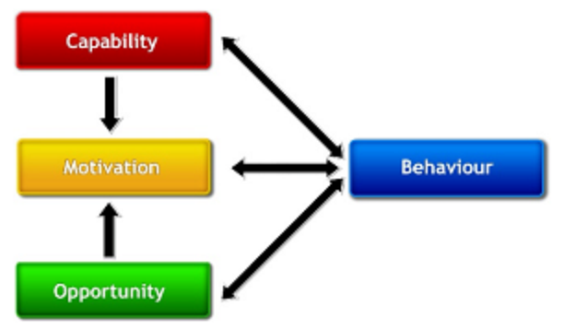
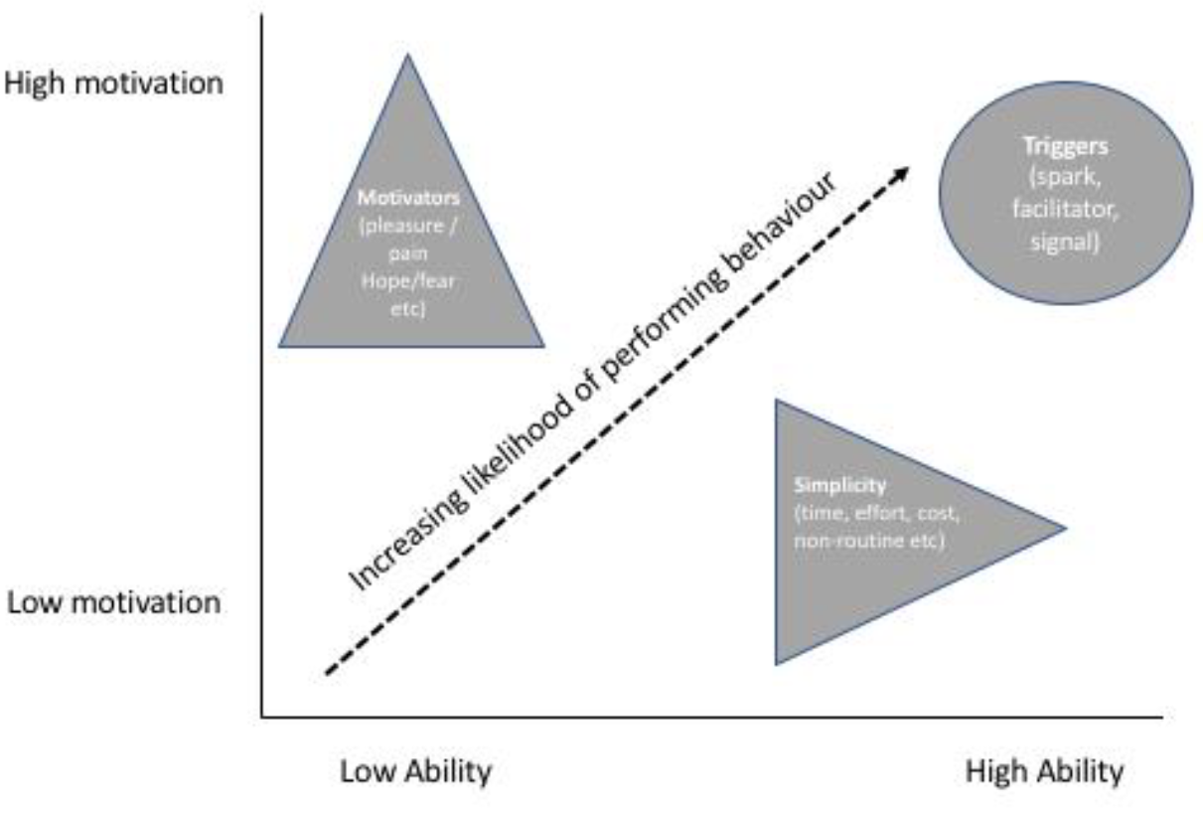
Behavioural Models:
Figure 2: COM-B (Michie et al., 2011)
Figure 3: B=MAT (ENISA, 2018)

Slide 4

Policies
Figure 4: Policies folder stock photo (CommLab India, 2014)

Slide 5
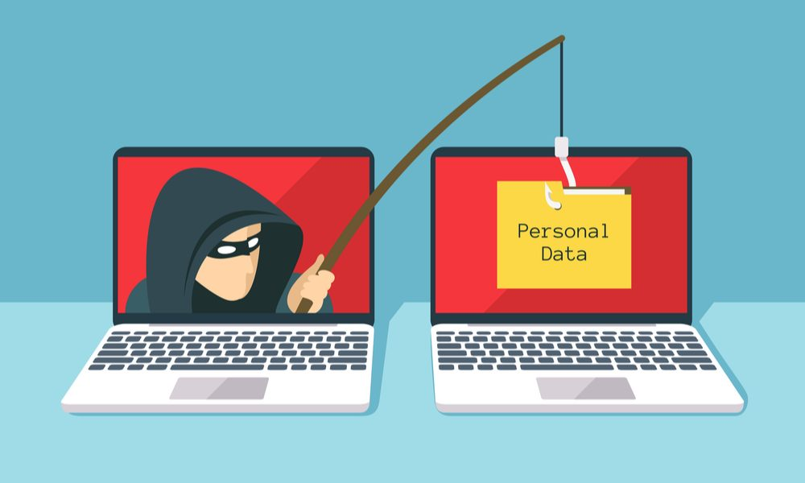
Mock Phishing Campaigns
Figure 5: Phishing attack stock photo (The Purbeck School, N.D.)

Slide 6

User Experience (UX) Design
Figure 6: Design board stock photo (Minhas, 2018)

Slide 7

Legal, Social, and Ethical Considerations
Figure 7: Men holding arrows stock photo (Millet & Jett, 2016)

Slide 8
The Menlo Report:
Respect for Persons
Participation as a research subject is voluntary and follows from informed consent
It requires that individuals are treated as autonomous agents and their righ to determine their own best interest is respected
Researchers should respect individuals who are not targets of research yet are impacted
Individuals with diminished autonomy, who are incapable of deciding for themselves are entitled to protection
Beneficence
This ensures no harm is done to any humans / users. It is achieved by maximising the probable benefits and minimising any potential harms. It requires systematically assessing both risks of harm, as well as the benefits
Justice
Each person deserves equal consideration in how they are treated, and that benefits of research should be fairly distributed according to the individual need, effort, societal contribution, and merit. It also states the selection of subjects be fair, and burdens should be allocated equitably across the impacted subjects.
Respect for Law and Public Interest
Ensures that researchers or designers engage in legal due diligence and that the methods employed, as well as research results, are transparent. It also ensures accountability of actions.
U.S. Department of Homeland Security (2012)

Slide 9

Other Considerations
Figure 8: Regulations and Rules Stock Photo (McDermott, 2011)

Slide 10
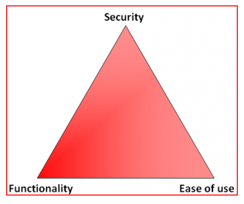
Conclusion
Figure 9: InfoSec Triads: Security/Functionality/Ease-of-use (Waite, 2010)

Slide 11
Appendix - Mitigation Mapping
MENTAL MODELS
Policies
IT Security Awareness
UX Design
TRUST
Mock Phishing Campaigns
IT Security Awareness Training (E.g. anti-Social Engineering)
HABITUATION
UX Design
The End

